Slide 1
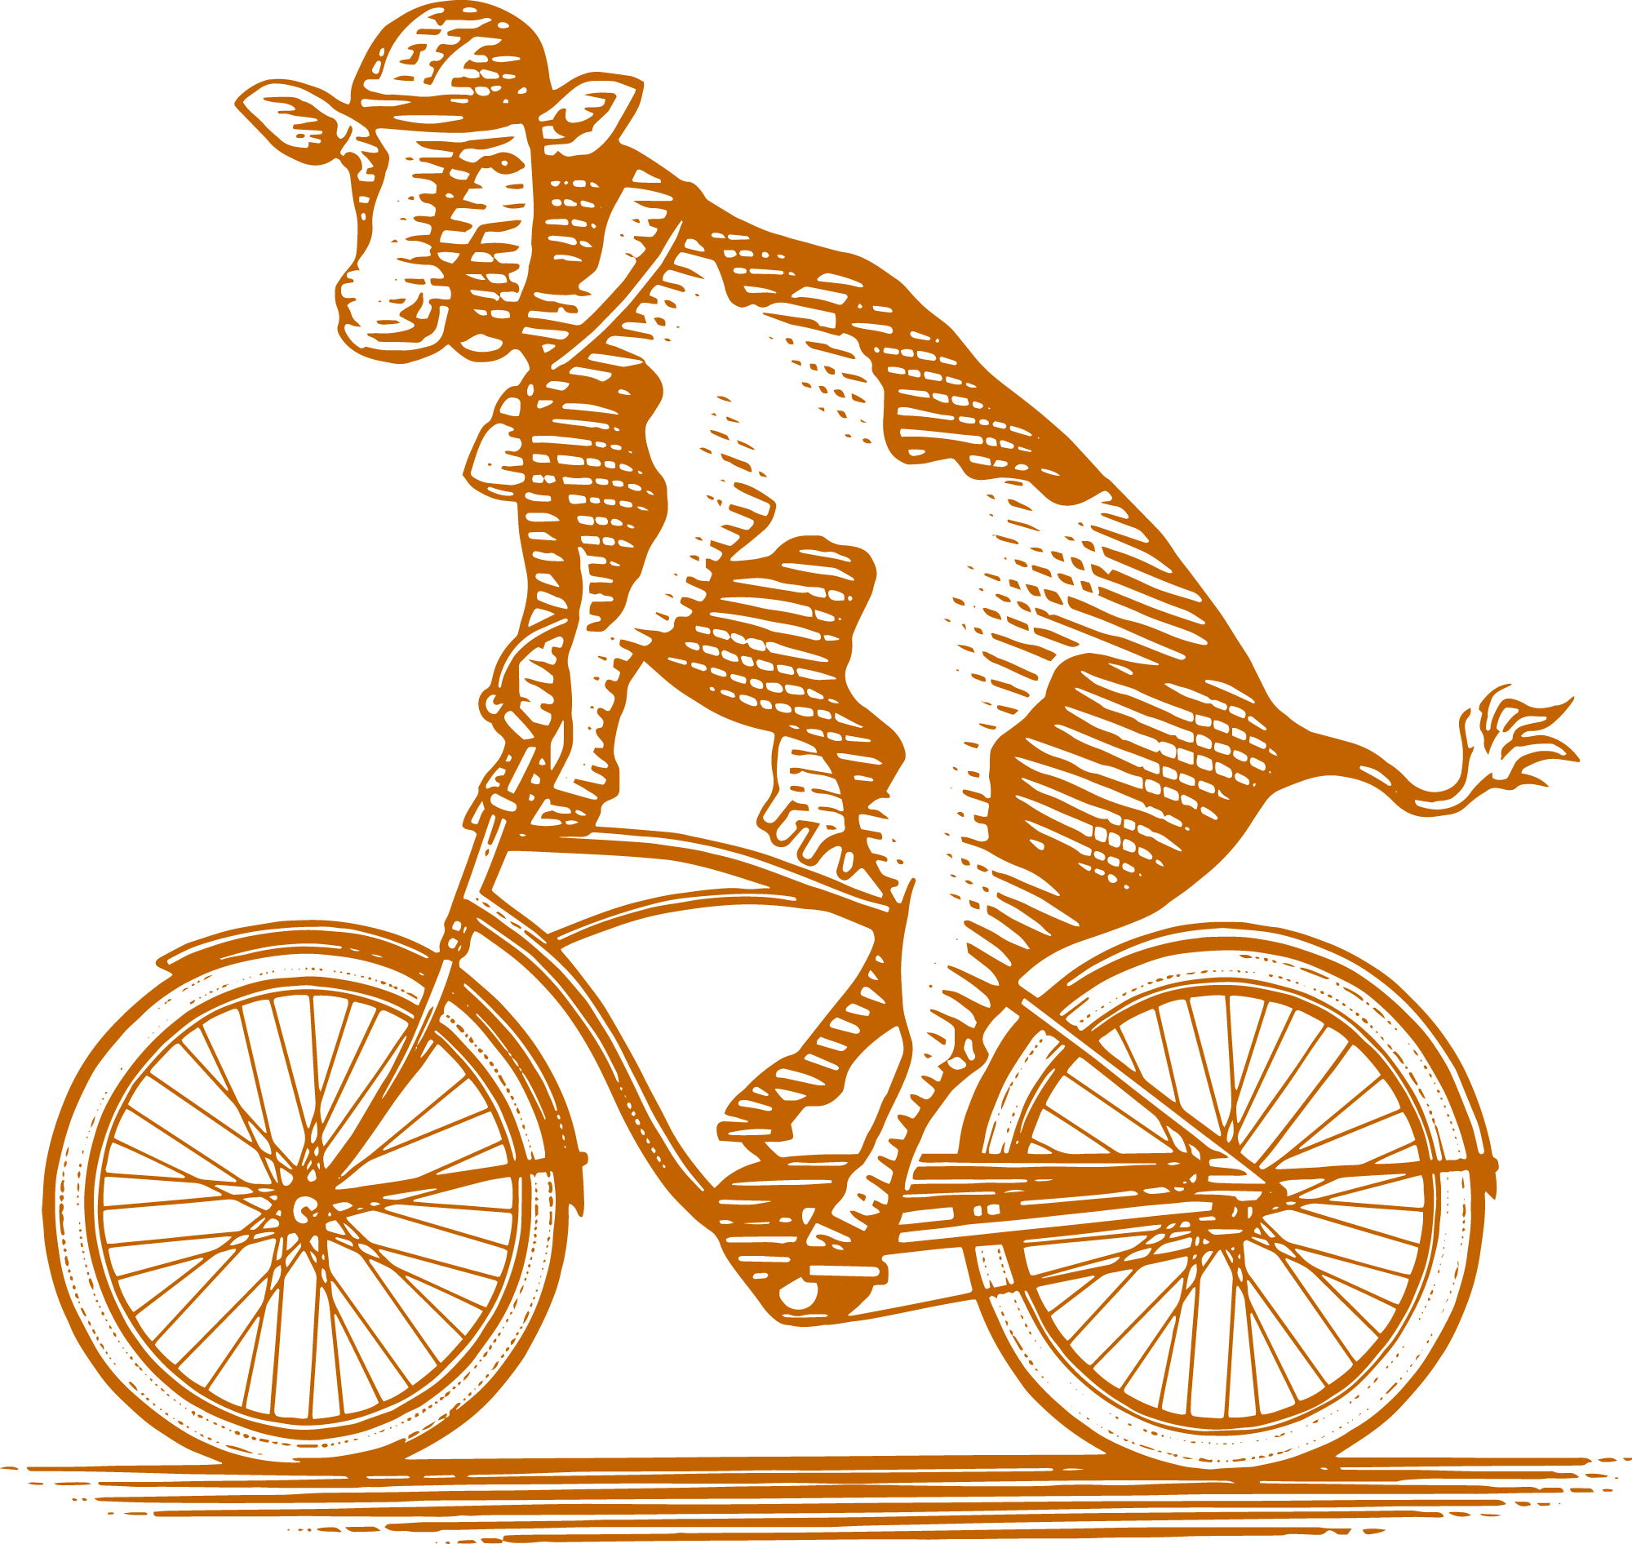
Data Visualization Dashboards with Plotly Dash
A zero-to-Hero demo

Slide 2
What is plotly dash?
Plotly: is a modern graphing library
Dash: is a framework to create interactive data visualization webapps.

Slide 3
Why use plotly & dash?
Fast development
Great Documentation
  Plotly
  Dash
Create tools that are
  Easy to use
  Professional looking
Example dash app

Slide 4
Workshop overview
plotly
  express
  Figure objects
dash
  minimal app
  layout + html
  dash core components
  callbacks
  styling
pixi

Slide 5
plotly
the plotting library

Slide 6
Quickly make a figure: plotly.express
In one function:
36 premade types of plots
Many input formats: lists, dicts, df’s, numpy
automatic labeling + layout config.
input data as df

Slide 7
Figures have methods
plotly.graph_objects.Figure — 6.4.0 documentation
Figure.add_traces | add plots to the figure
Figure.update_layout | change the figs layout dictionary struct.
Figure.update_xaxes (and y axis) | change or add objects on axis
Figure.add_vline (other shapes as well) | adds a vertical line to the figure
a krillion more…

Slide 8
dash
the webapp framework

Slide 9
Live demo of making a dash app
The minimal hello world app
Add graph and dropdown component
Use callback to update graph depending on dropdown menu
Add a slider and moving line
Style app using bootstrap theme
Make multi page app using previous apps

Slide 10


To make dash app run you need (3):
the “Dash constructor”
  app = Dash()
the app layout structure
  wrapper for html
run app

Slide 11
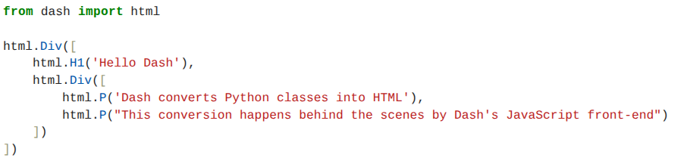
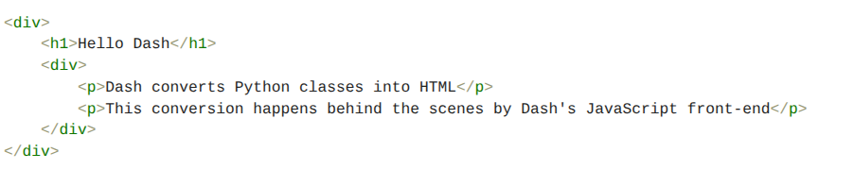
app layout & html
App layout structure is written in a python wrapper around html

Slide 12
dash components & html components
dash components are:
from dash import dcc
https://dash.plotly.com/dash-core-components
many interactive components you can add to layout
html components are:
from dash import html
https://dash.plotly.com/dash-html-components
“Dash is a web app framework that provides pure Python abstraction around HTML, CSS, and JavaScript.”

Slide 13

dash & html components have
id’s that can be referenced
attributes that can be changed
! dash apps are interactive because user inputs can be used to change the attributes of dash and html components
id’s
attribute’s

Slide 14
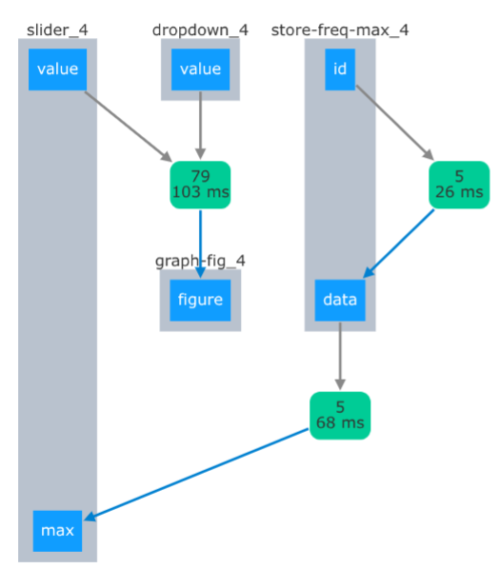

What are callbacks?
callbacks detect when components have been triggered (inputs), and target components the reference (outputs)
id
attribute

Slide 15
style your app with bootstrap themes
Guide: Themes - dbc docs
View components with theme: Theme explorer - dbc docs
Use the theme browser: Dash Bootstrap Theme Explorer
add:
dbc_css style sheet
external style sheet to dash constructor
className="dbc" CSS class selector around layout

Slide 16
to turn single page to multi page
you must:
not have any duplicate id’s or functions across pages
remove dash constructor from sub pages
add dash.register_page(__name__) to sub pages
add use_pages=True in main dash constructor

